Slide 1
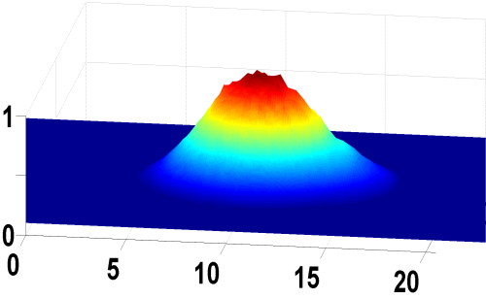
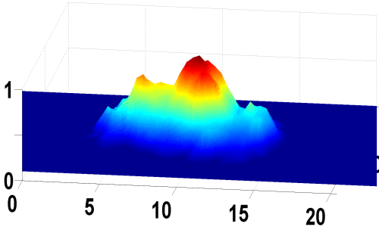
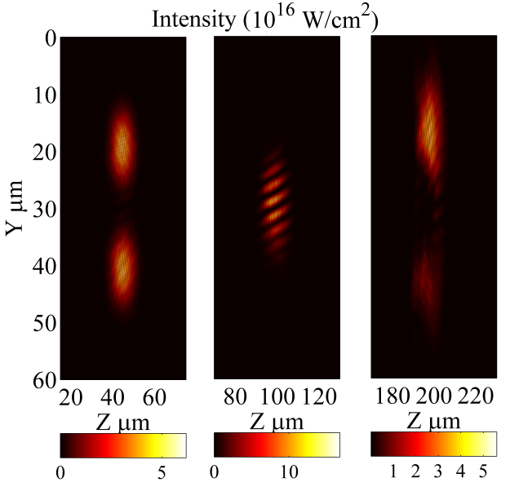
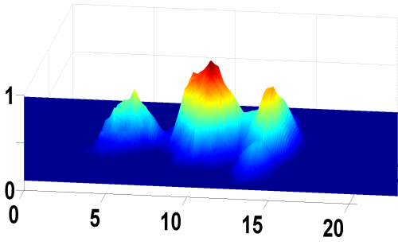
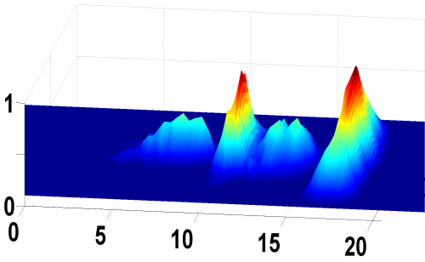
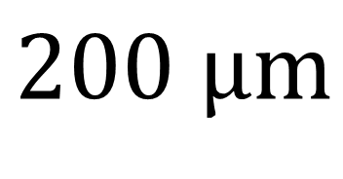


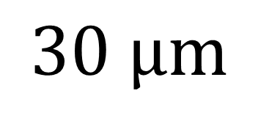

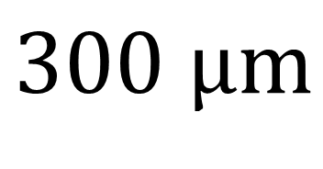
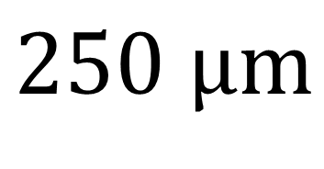

Pulse self-modulation and energy transfer between two intersecting laser filaments by self-induced plasma waveguide arrays
R. Kupfer, B. Barmashenko and I. Bar
Department of Physics, Ben-Gurion University of the Negev
$$30 μm$$
$$200 μm$$
$$μm$$
$$μm$$
$$250 μm$$
$$300 μm$$
$$μm$$
$$μm$$
Notes:
Good afternoon. I’m going to speak about particle-in-cell simulation of femtosecond laser pulse propagating in plasma. Basically, we are interested in this little bright dot here.

Slide 2
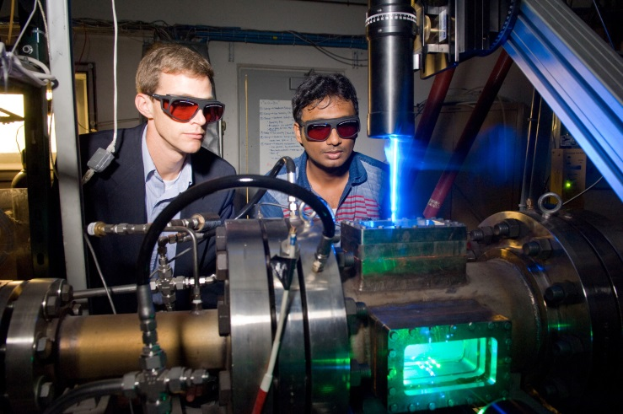
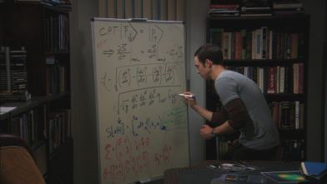

Computational physics in the eyes of experimentalists and theorists

Slide 3
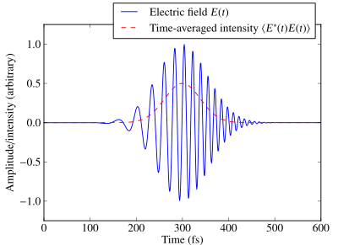
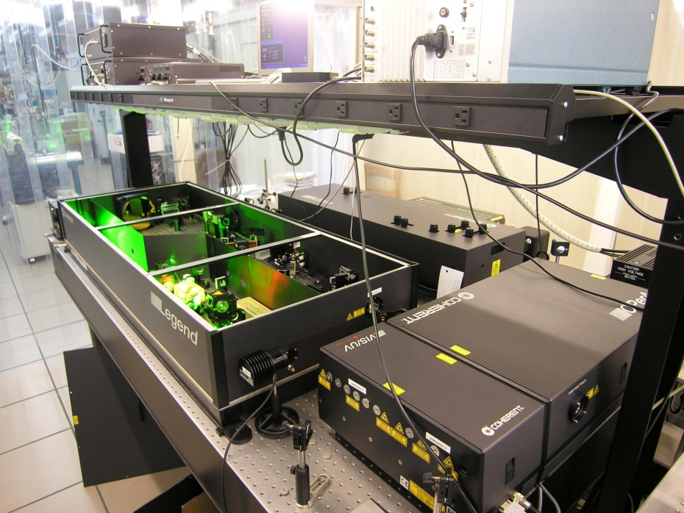
Ultrafast lasers
1fs = 10⁻¹⁵ sec = 0.000000000000001 sec
Peak intensity > 10¹⁶ W/cm² = 10000000000000000 W/cm²

Slide 4
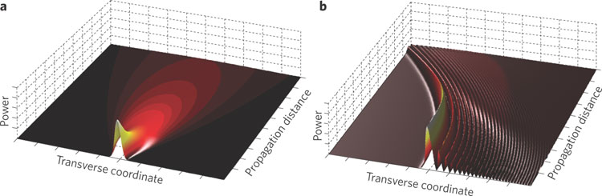
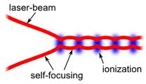
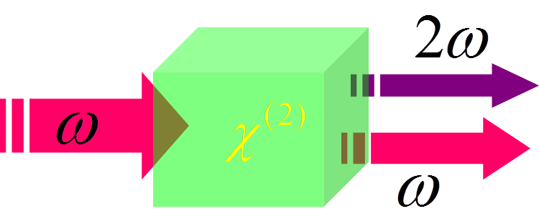
Nonlinear optics
Light interacts with light via the medium
Intensity dependent refractive index
Light can alter its frequency

Slide 5
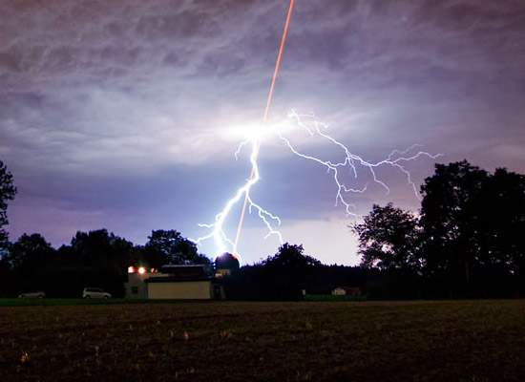
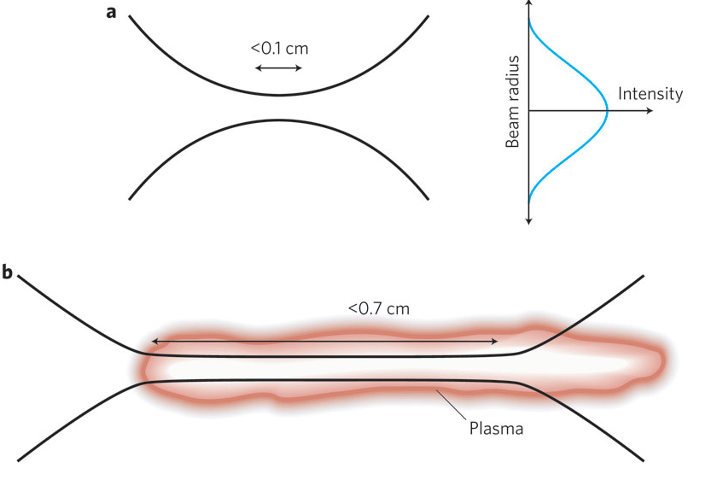
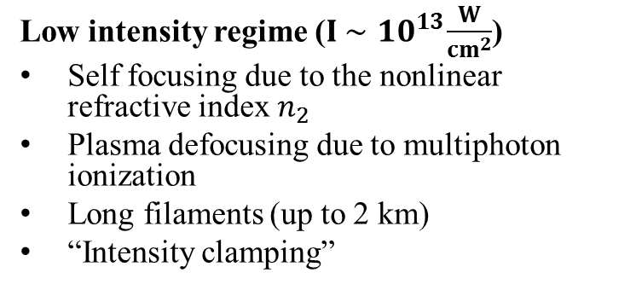
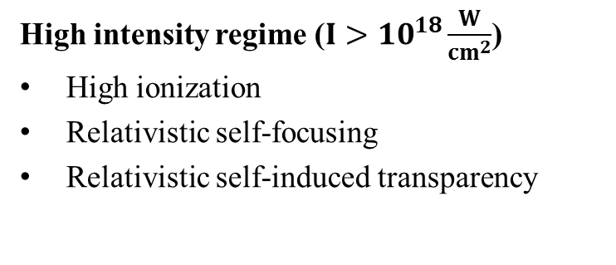
Propagation of ultrafast laser pulses in air
Low intensity regime ($I \sim { 10}^{13}\frac{W}{{cm}^{2}}$)
Self focusing due to the nonlinear refractive index $n_{2}$
Plasma defocusing due to multiphoton ionization
Long filaments (up to 2 km)
“Intensity clamping”
High intensity regime ($I>{10}^{18}\frac{W}{{cm}^{2}}$)
High ionization
Relativistic self-focusing
Relativistic self-induced transparency
A. Couairon and A. Mysyrowicz, Phys. Rep. 441, 47(2006).
Notes:
It is common to divide femtosecond pulse propagation air into two intensity regimes. The “Low intensity regime” is for intensities in the area of 10^13 w/cm^2. When focusing a laser beam with a long lens, let’s say 2 m, the beam experience two opposing processes. The first is self focusing due to the nonlinear refractive index n2 of the air molecules that tends to focus the beam. The second is plasma defocusing, caused by multiphoton ionization is the process of plasma creation. When the intensity reaches a value where both process are equal in strength the beam propagates in a form of a long filament with almost constant diameter except for small changes in focusing-defocusing cycles.

Slide 6
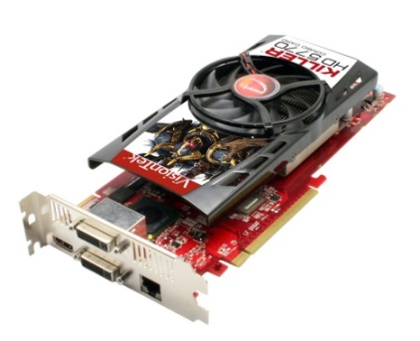











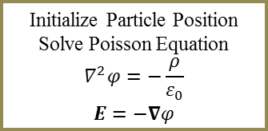
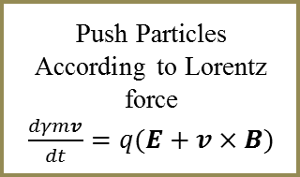
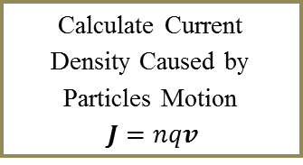
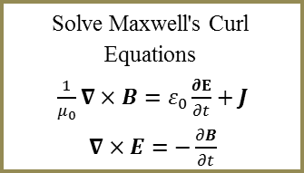
Algorithm description
Initialize Particle Position
Solve Poisson Equation
$$∇^{2}φ=−\frac{ρ}{ε_{0}}$$
$$E=−∇φ$$
The pulse parameters can be controlled: Duration, intensity, spatial and temporal profile, linewidth, angle, waist and wavelength
The simulation area is surrounded by a perfectly matched layer.
Spectrum analysis using Goertzel algorithm
Only numerical assumptions
Launch a Pulse on the Simulation Edge
Solve Maxwell's Curl Equations
$\frac{1}{μ_{0}}∇×B=ε_{0}\frac{∂E}{∂t}+J$
$∇×E=−\frac{∂B}{∂t}$
E_{i,j}
J_{x i+1,j}
H_{i,j}
Calculate Current Density Caused by Particles Motion
$J=nqv$
Push Particles According to Lorentz force
$\frac{dγmv}{dt}=q(E+v×B)$
J_{y i,j+1}
Analyze Spectrum of Outgoing Pulse on the Edge
A. Taflove and S. C. Hagness, Computational Electrodynamics: The Finite-Difference Time-Domain Method, 3rd ed., Norwood, MA (2005).
Notes:
Pulses are lunched on the edges by setting the electric and magnetic fields with proper spatial phase. All the pulse parameters can be controlled: Pulse duration, intensity, spatial and temporal profile, linewidth, incident angle, waist diameter and wavelength. Spectral linewidth is generated by a superposition of a finite number of pulses with different wavelengths leading to a Gaussian shaped spectrum. On the edges Berenger’s perfectly matched layer absorbs all outgoing waves. Outgoing particles are also neglected. Current density is calculated using Umeda’s zigzag scheme which is charge conserving (so we don’t need to solve Poisson equation again). Particles are pushed using Boris scheme (Which is basically half-push , rotation and half push).
Spectrum analysis using Goertzel algorithm that gives better spectral resolution that FFT.

Slide 7
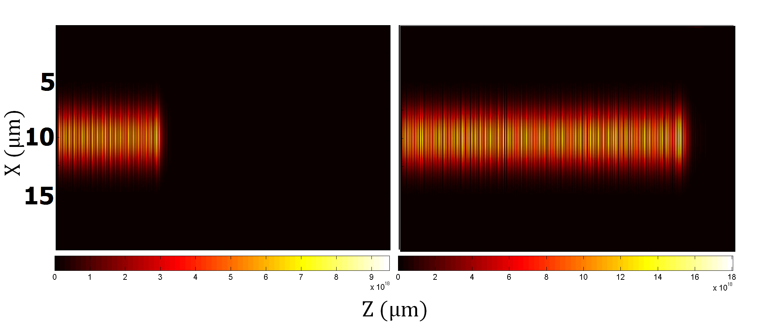
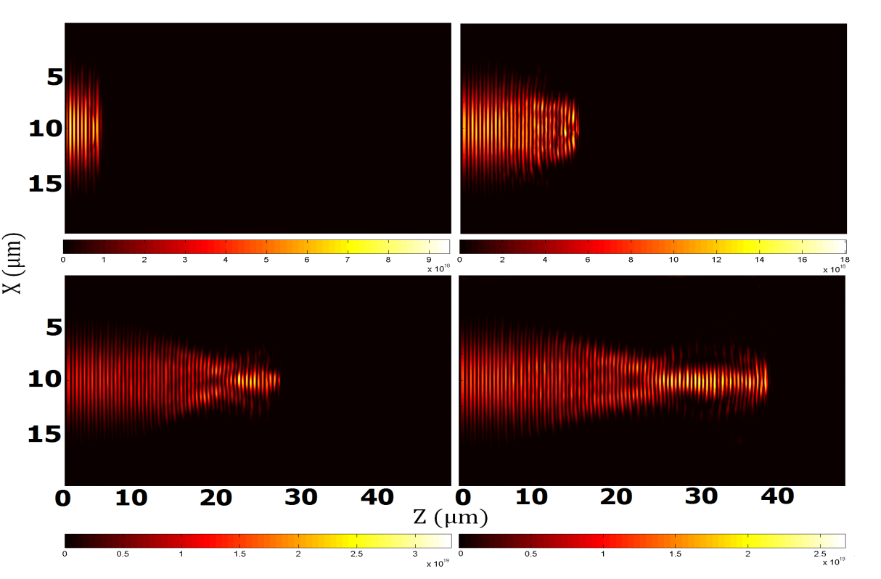
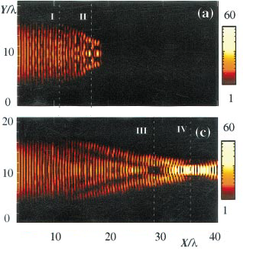
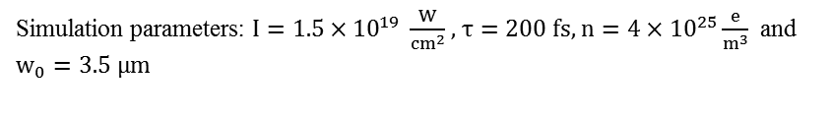
Relativistic self-focusing
A. Pukhov and J. Meyer-ter-Vehn, Phys. Rev. Lett. 76, 3975 (1996).
Simulation parameters: $I=1.5×{10}^{19} \frac{W}{{cm}^{2}}$, $τ=200 fs,$ $n=4×{10}^{25}\frac{e}{m^{3}}$ and $w_{0}=3.5 μm$
Notes:
Here we tested the code for relativistic self-focusing. Above, you can see the beam propagating in vacuum (we assume long focal distance).

Slide 8
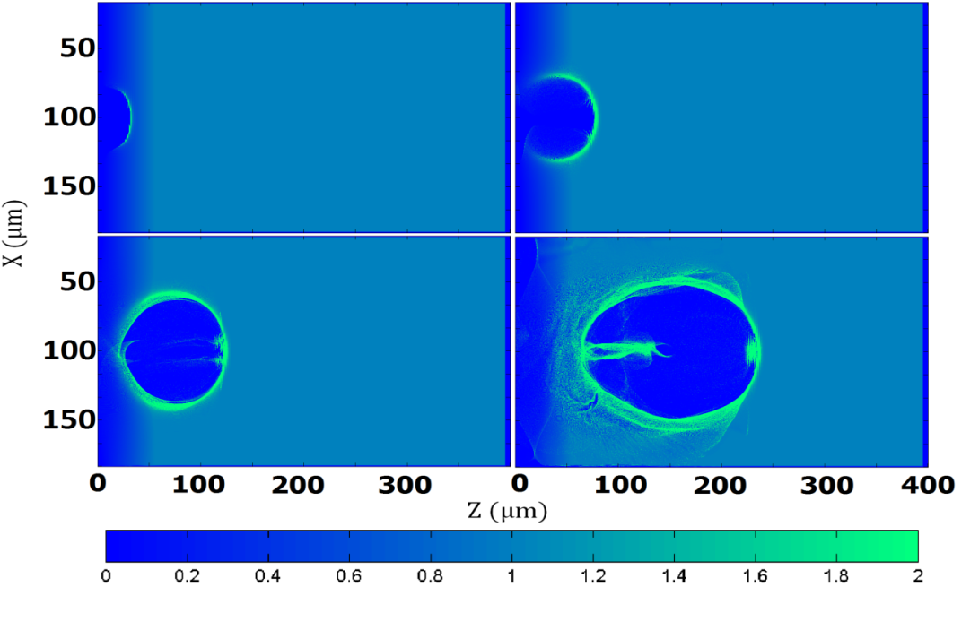
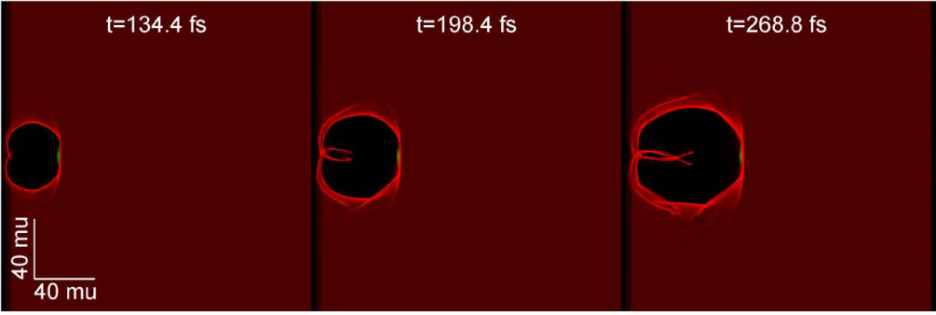
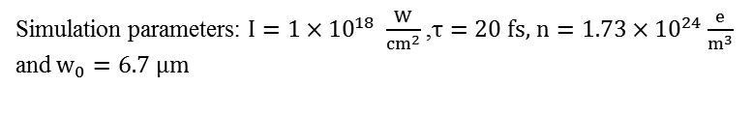
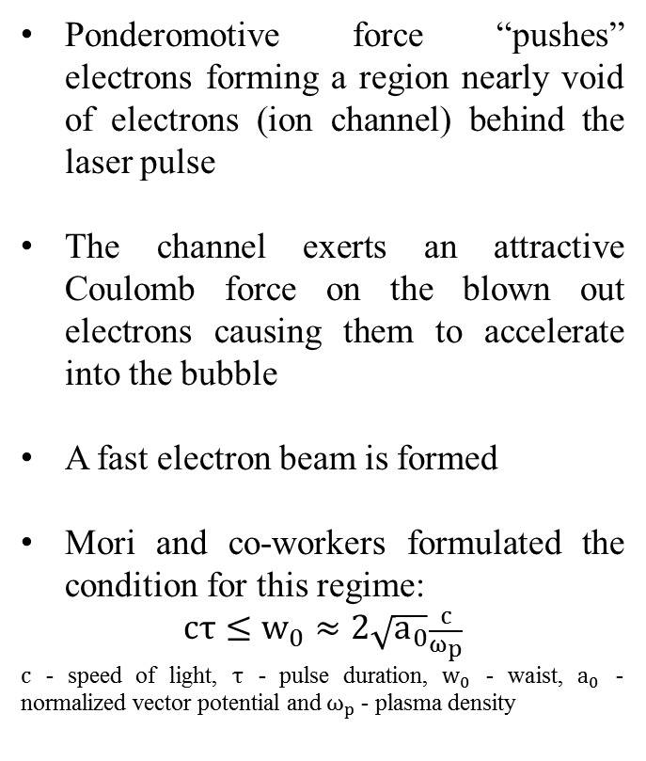
Single bubble regime
Pulse position
Ponderomotive force “pushes” electrons forming a region nearly void of electrons (ion channel) behind the laser pulse
The channel exerts an attractive Coulomb force on the blown out electrons causing them to accelerate into the bubble
A fast electron beam is formed
Mori and co-workers formulated the condition for this regime:
$cτ≤w_{0}≈2\sqrt{a_{0}}\frac{c}{ω_{p}}$
$c$ - speed of light, $τ$ - pulse duration, $w_{0}$ - waist, $a_{0}$ - normalized vector potential and $ω_{p}$ - plasma density
Fast electron beam
Simulation parameters: $I=1×{10}^{18} \frac{W}{{cm}^{2}}$ ,$τ=20 fs,$ $n=1.73×{10}^{24}\frac{e}{m^{3}}$ and $w_{0}=6.7 μm$
H. Burau et al. IEEE Trans. Plasma. Sci. 38, 2831 (2010).
W. Lu, M. Tzoufras, C. Joshi, F. S. Tsung and W. B. Mori, Phys. Rev. ST Accel. Beams 10, 061301 (2007).
Notes:
We tested our numerical kernel for a couple of scenarios to ensure it works properly. The first is called the “Bubble regime”. Here you can see a density plot of the electrons. The pulse position is marked. The pulse pushes the electrons (which are called “blown out” electrons) and create an ion bubble (the electrons on the outside pushes the blown electrons back). The electron void (or ion channel) attracts electrons from behind into the bubble, forming a fast electron beam. The condition for a single bubble formation was formulated in 2007 by Mori and co-workers.

Slide 9
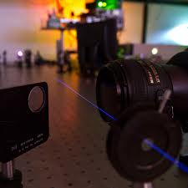
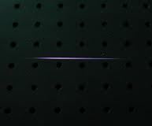
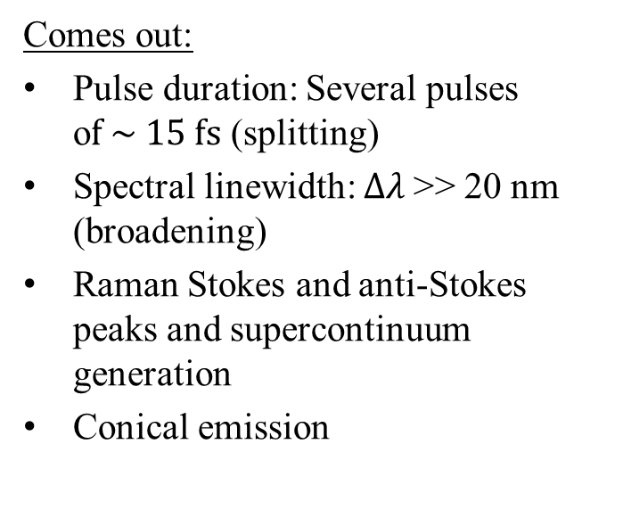
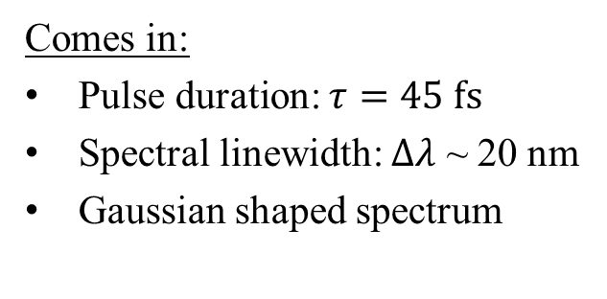
Objective – spectral and spatiotemporal evolution
Comes in:
Pulse duration: $τ=45 fs$
Spectral linewidth: $∆λ$ ~ 20 nm
Gaussian shaped spectrum
Comes out:
Pulse duration: Several pulses o$f \sim 15 fs$ (splitting)
Spectral linewidth: $∆λ$>> 20 nm (broadening)
Raman Stokes and anti-Stokes peaks and supercontinuum generation
Conical emission
?
Notes:
So what is our problem? Let’s say you have a laser pulse with duration of ~50fs, energy of ~1 mJ and wavelength of 800nm and you focus it using a short lens (let’s say 10 cm). Near the waist, the laser ionize the air forming a plasma channel (that you can see here, although, for a short lens it is much shorter, less then a mm in length). The laser goes out in the other side of the channel and you find that it changed. It splits into several shorter pulses, its spectrum is wider and blue shifted and there are Raman peaks in the spectrum. All this changes take place in a very short distance.

Slide 10
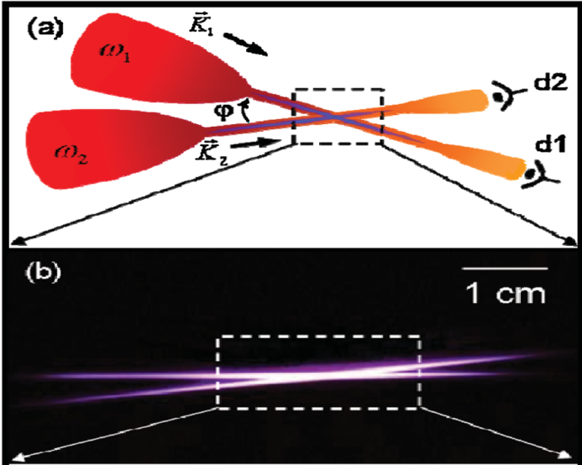
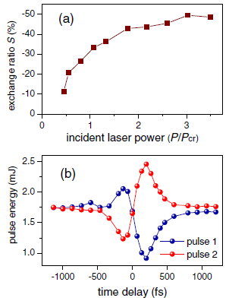
Objective – energy transfer between intersecting beams
Y. Liu, M. Durand, S. Chen, A. Houard, B. Prade, B. Forestiers, and A. Mysyrowic, Phys. Rev. Lett. 105, 055003 (2010).
Notes:
So what is our problem? Let’s say you have a laser pulse with duration of ~50fs, energy of ~1 mJ and wavelength of 800nm and you focus it using a short lens (let’s say 10 cm). Near the waist, the laser ionize the air forming a plasma channel (that you can see here, although, for a short lens it is much shorter, less then a mm in length). The laser goes out in the other side of the channel and you find that it changed. It splits into several shorter pulses, its spectrum is wider and blue shifted and there are Raman peaks in the spectrum. All this changes take place in a very short distance.

Slide 11
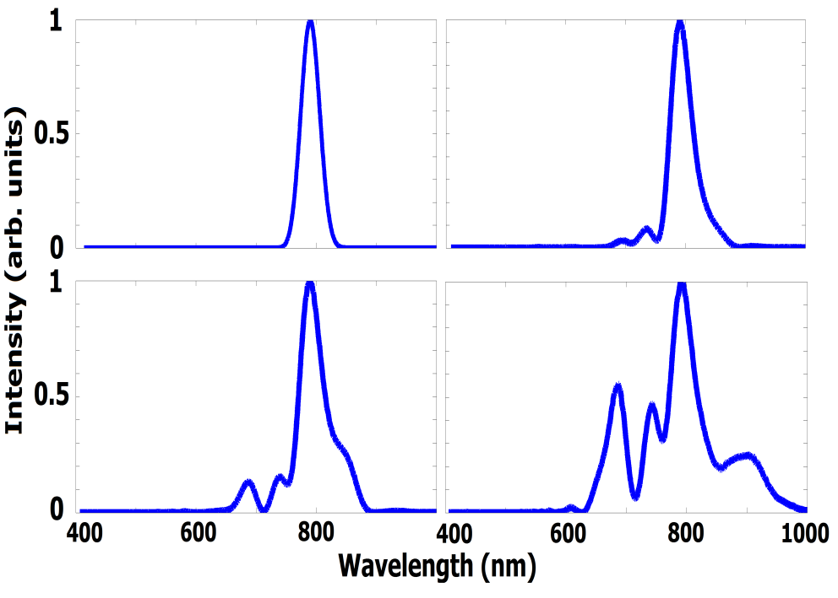
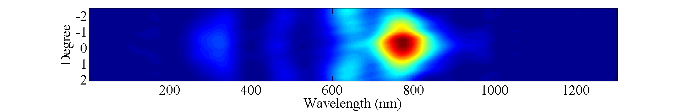




Spectral and temporal evolution
$$30 μm$$
$$200 μm$$
$$30 μm$$
$$200 μm$$
$$μm$$
$$μm$$
$$250 μm$$
$$300 μm$$
$$250 μm$$
$$300 μm$$
$$μm$$
$$μm$$
Simulation parameters: $I=6×{10}^{16} \frac{W}{{cm}^{2}}$ ,$τ=45 fs,$ $n=2.1×{10}^{25}\frac{e}{m^{3}}$ and $w_{0}=5.3 μm$
Simulation parameters: $I=6×{10}^{16} \frac{W}{{cm}^{2}}$ ,$τ=34 fs,$ $n=2.1×{10}^{25}\frac{e}{m^{3}}$ and $w_{0}=5.3 μm$
Notes:
Here we checked what happens to a 45 fs pulse when it propagates in a plasma channel. On the left you can see that the pulse start with a Gaussian line shape centered at 800nm. After 200micrometer of propagation, Anti stokes peaks start to grow. After 300 micrometer stokes peak start to grow. On the spatio-temporal domain, to pulse splits into 4 shorter pulses and each of them experience self-stepening. Here is a typical expeimental spectum for the same parameters. Here you can see experimental time-domain plot for the splitting for a longer propagation.

Slide 12
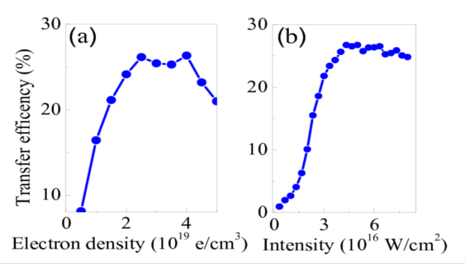
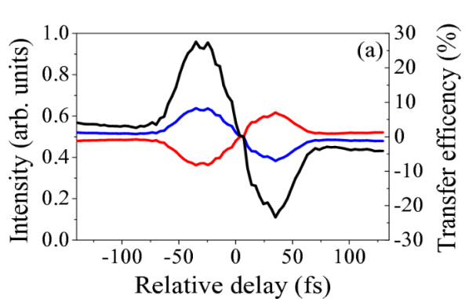
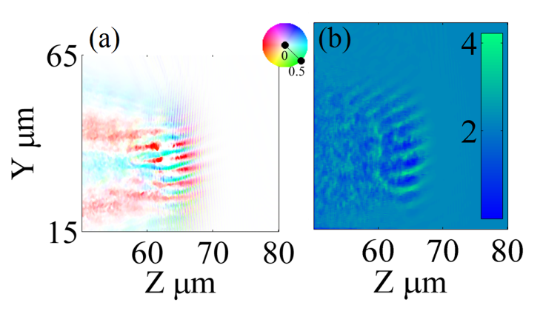
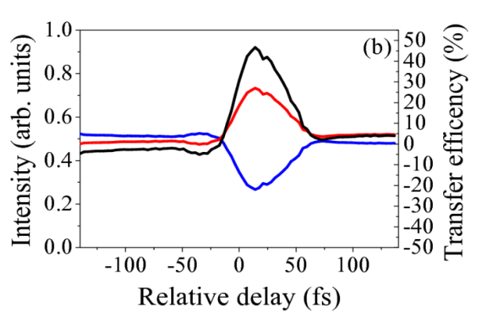
Energy transfer between intersecting beams

Slide 13
Conclusions
PIC simulation of the spectral and spatio-temporal evolution of a single pulse in a high density plasma channel, as well as energy transfer between two intersecting pulses
The simulation results were found to be in agreement with previously obtained experimental results
Efficient frequency conversion and energy transfer can be achieved in a compact and simple setup and over very short distances
It is anticipated that this model will be able to simulate laser-plasma interactions even in more complicated geometries and to predict the behavior under different conditions
Future work
Characterization of localized surface plasmons in nanoparticle arrays
Second harmonic generation from irradiated solid targets
Raman and Brillouin scattering in liquids

