Slide 1

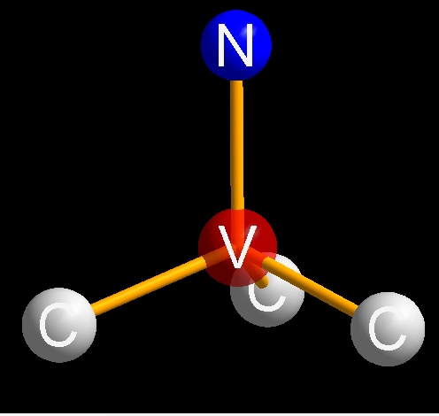
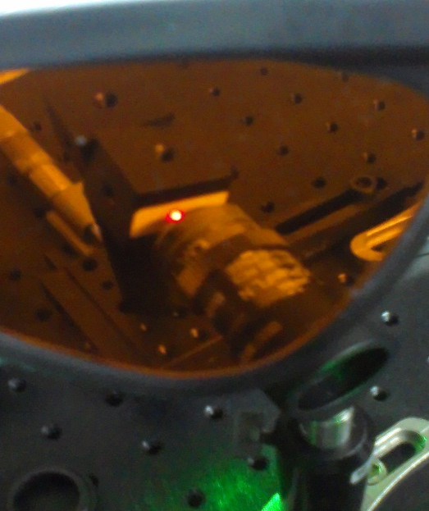
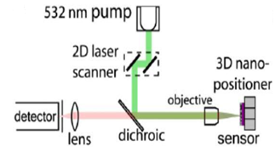
Nitrogen-Vacancy Center in Diamonds Physics and Magnetometry
Atom Chip Group
Ben Gurion University

Slide 2
Outline
Quantum systems, their hallmarks and technological applications.
Why can’t Quantum mechanics be observed in solid states.
The nitrogen-vacancy center in diamonds, a unique room-temperature quantum system
Using the nitrogen-vacancy as a magnetic sensor for scientific and technological applications
Atom Chip Group
Ben Gurion University

Slide 3

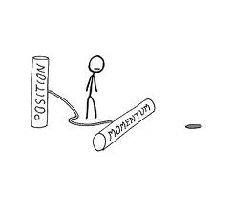
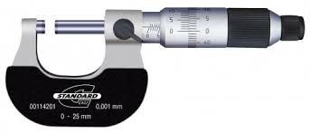
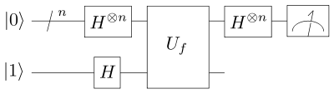
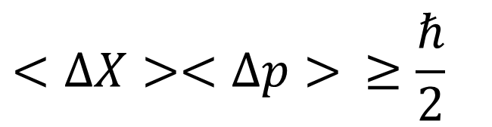
Quantum systems
Uncertainty Principle
Superposition
$$<ΔX><Δp> ≥\frac{ℏ}{2}$$
High precision measurement
Quantum computing

Slide 4
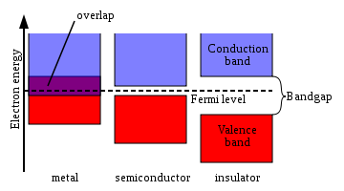
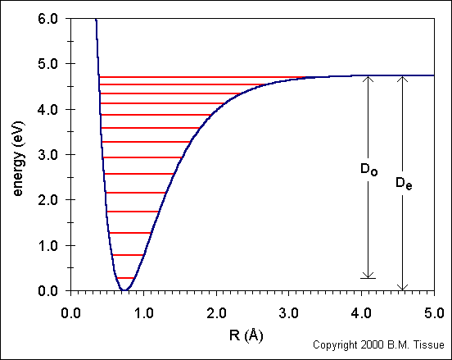






Quantum systems
Degrees of freedom splits the energy levels
In solid state we almost always get Electronic band structure
$$m_{s}=\frac{1}{2}$$
$$m_{I}=\frac{1}{2}$$
$$m_{I}=−\frac{1}{2}$$
$$m_{I}=\frac{1}{2}$$
$$m_{s}=−\frac{1}{2}$$
$$m_{I}=−\frac{1}{2}$$
Very short coherence time due to interactions with phonons

Slide 5
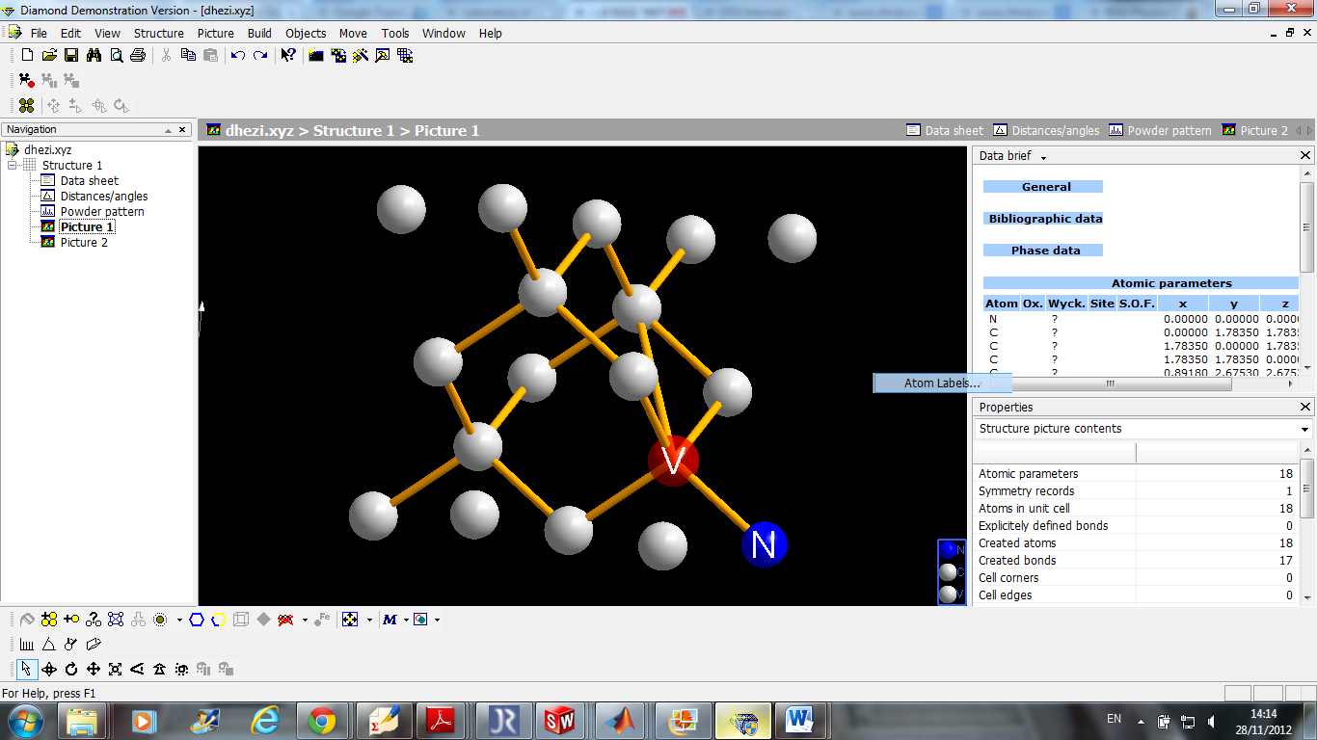
The Nitrogen-Vacancy center in diamond
Diamond is an FCC carbon crystal
There is natural abundance of nitrogen in the crystal
Vacancy is generated using high energy radiation.
The crystal is annealed to trap the vacancies near the N atoms
The resulting center has C3v symmetry and a spin-1 behavior

Slide 6
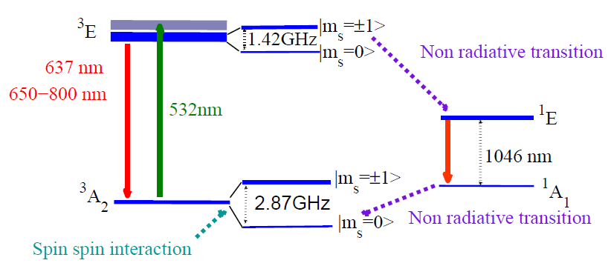
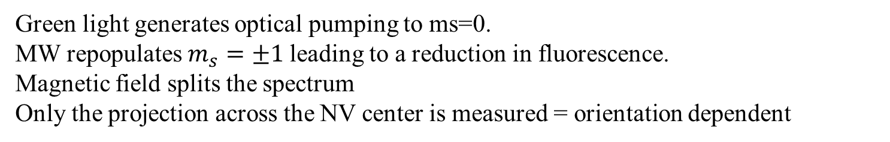
The Nitrogen-Vacancy center in diamond
Green light generates optical pumping to ms=0.
MW repopulates $m_{s}=±1$leading to a reduction in fluorescence.
Magnetic field splits the spectrum
Only the projection across the NV center is measured = orientation dependent

Slide 7
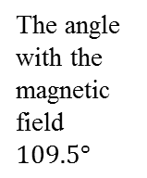


The Nitrogen-Vacancy center in diamond
$$B≈0.5 G$$
$$B≈15 G$$
Normalized fluorescence
Normalized fluorescence
ms=-1
ms=1
The angle with the magnetic field $109.5°$
MW [GHz]
MW [GHz]
Fluorescence [a. u]

Slide 8
Summery
Quantum systems, their hallmarks and technological applications.
Why can’t Quantum mechanics be observed in solid states.
The nitrogen-vacancy center in diamonds, a unique room-temperature quantum system
Using the nitrogen-vacancy as a magnetic sensor for scientific and technological applications

Slide 9
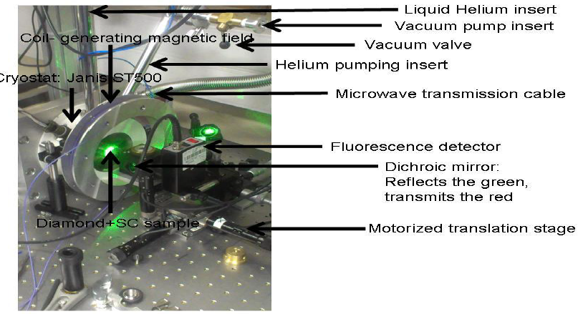
Thank You
Atom Chip Group
Ben Gurion University

Slide 10
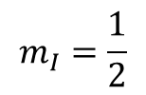
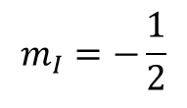
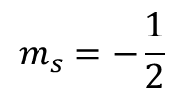
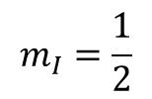
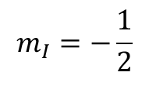
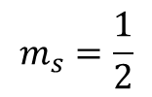
$$m_{s}=\frac{1}{2}$$
$$m_{I}=\frac{1}{2}$$
$$m_{I}=−\frac{1}{2}$$
$$m_{I}=\frac{1}{2}$$
$$m_{s}=−\frac{1}{2}$$
$$m_{I}=−\frac{1}{2}$$

