Slide 1
Microfluidics @ BGU Physics Department: Going with the (Laminar) Flow
Ben Gurion University of the Negev
Faculty of Natural Sciences
Department of Physics
Physics Fete – March 2013
Gadi Afek

Slide 2
OUTLINE
What is Microfluidics & what is it Good for?
Going with the Laminar Flow
One Step Forward – “Lab on a Chip”
A-Chip-a-Day
Some Applications
µF in our Lab

Slide 3
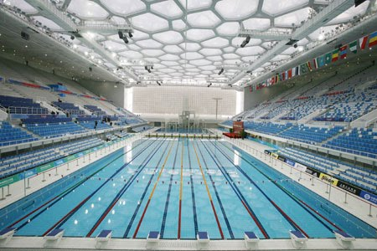
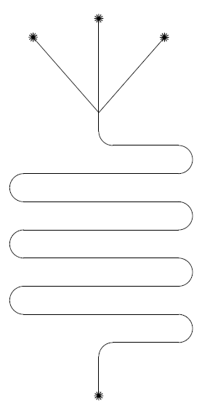
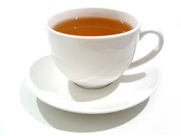
WHAT IS MICROFLUIDICS?
Manipulation of fluids at very small volumes, typically µl-fl
~1x10⁻⁹ liter:
µF Psi mixer
~1x10⁻¹ liter:
Standard US cup o’ tea
~1x10⁷ liter:
4 Olympic-sized swimming pools

Slide 4
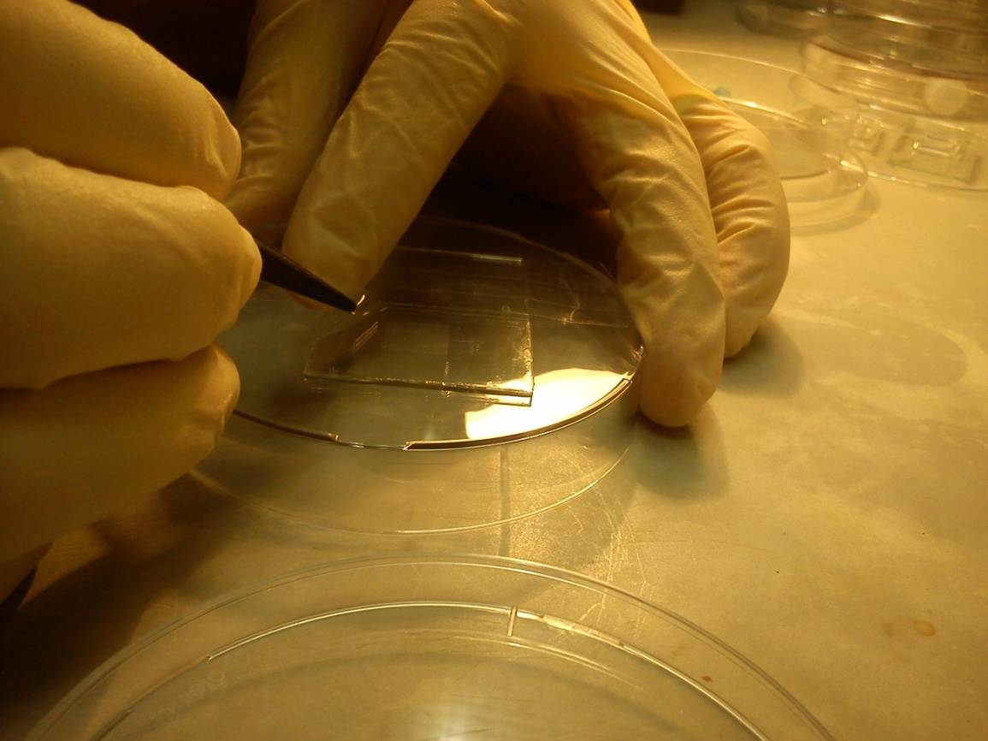
WHAT IS IT GOOD FOR?
Devices are transparent (good optical properties)
They allow precise control of small particles in fluid (good for simulating biological systems)
Biocompatible (non toxic)
Interesting for laminar-
flow hydrodynamics
Fast and flexible to design
Low manufacturing cost

Slide 5
GOING WITH THE LAMINAR FLOW
Reynolds number is given by-
Where u is velocity, L is length scale, µ is the dynamic viscosity, ρ is the density and v is the kinematic viscosity
Re number can be described as a ratio between inertial and viscous forces:
Reynolds number indicates flow regime

Slide 6
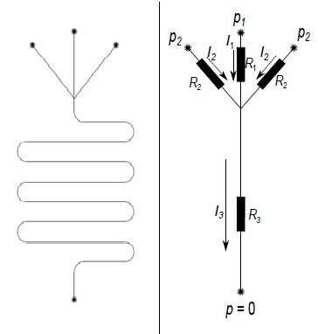
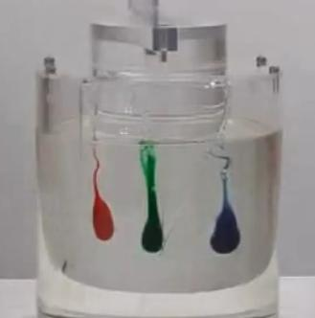
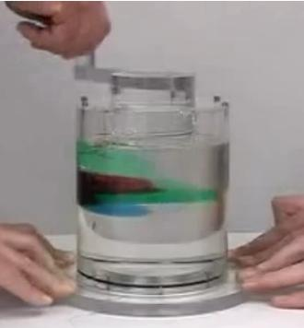
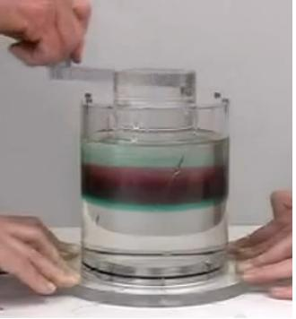
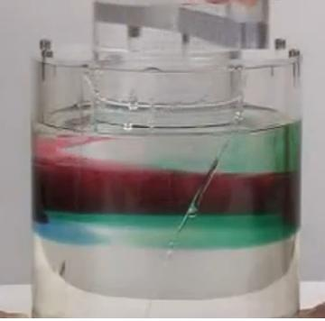
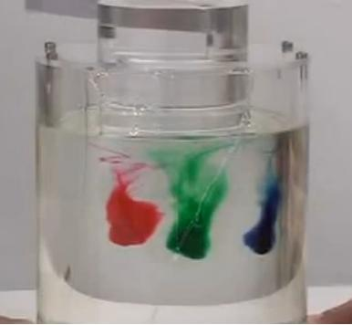
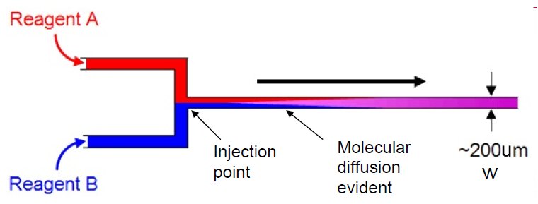
GOING WITH THE LAMINAR FLOW
What does this all mean?
Behavoiur described by Hagen-Poiseuille equation (electrical analogue)
Flow is reversible
Mixing governed entirely by diffusion

Slide 7
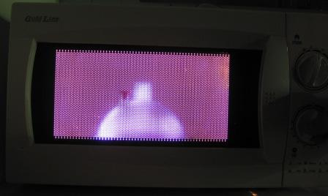
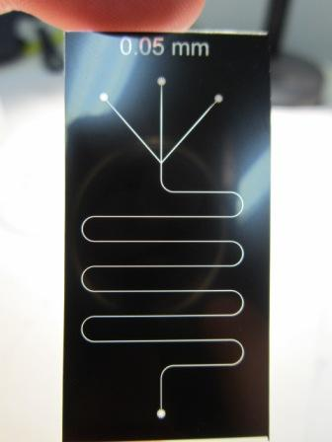
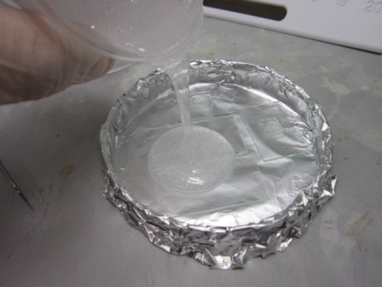
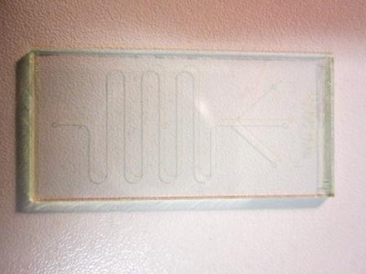
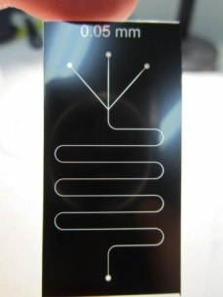
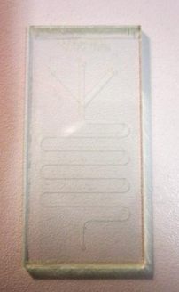
A-CHIP-A-DAY
From idea to device in less than a day – design and fabrication (photolithography):
Sketch pattern
Print negative on high-resolution transparency (MASK)
Coat clean glass (or Si) with photoresist, apply mask and expose to UV
“Develop” to get positive pattern (MASTER)
Pour pre mixed PDMS, degass and bake
Stick on glass using plasma bonding

Slide 8
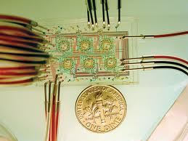
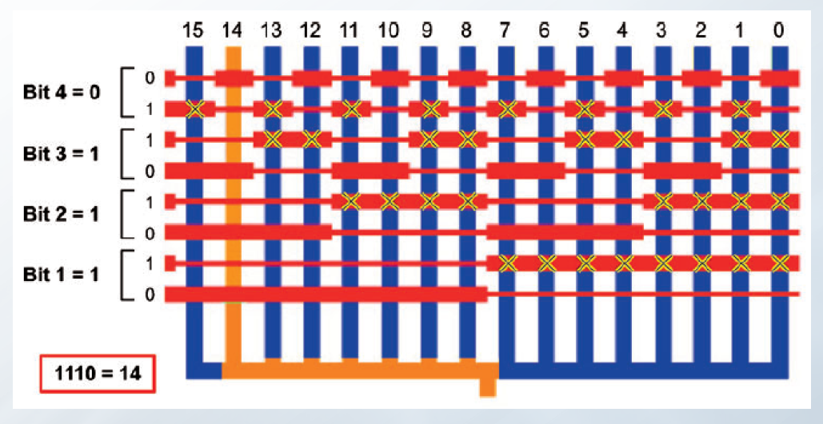
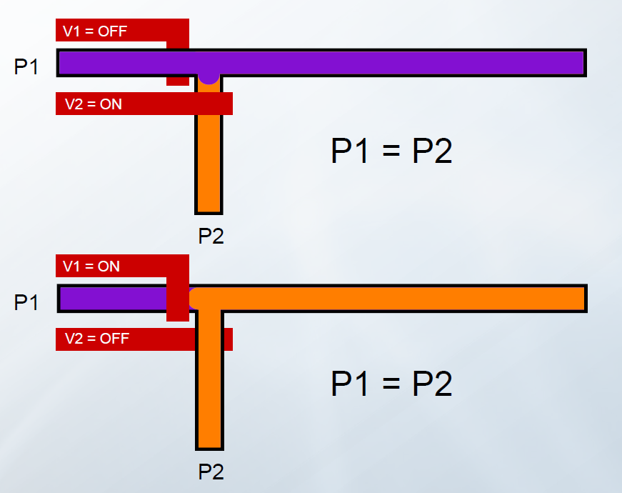
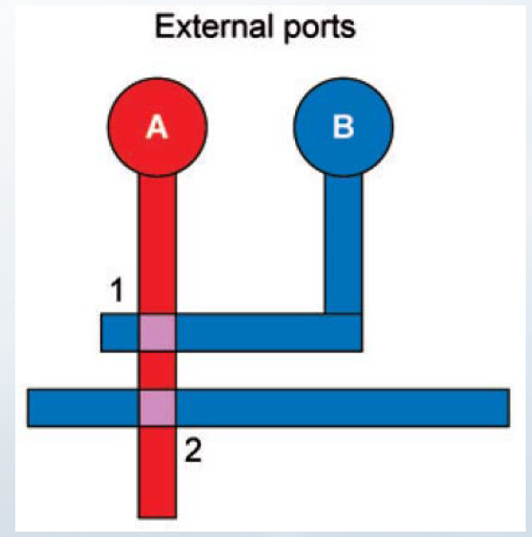
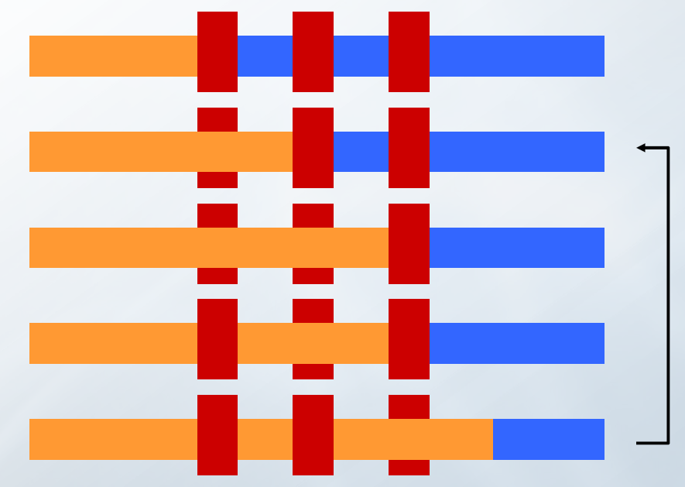
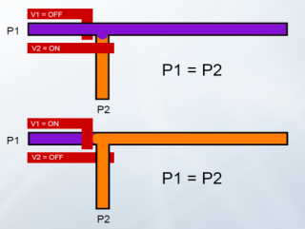
LAB-ON-A-CHIP (Honey, I Shrunk the Lab..)
Can multiplex devices (multiple layers) to form elaborate control mechanisms (valves, pumps etc.)
Valves
Latches (logical gates, anyone?)
Pumps

Slide 9
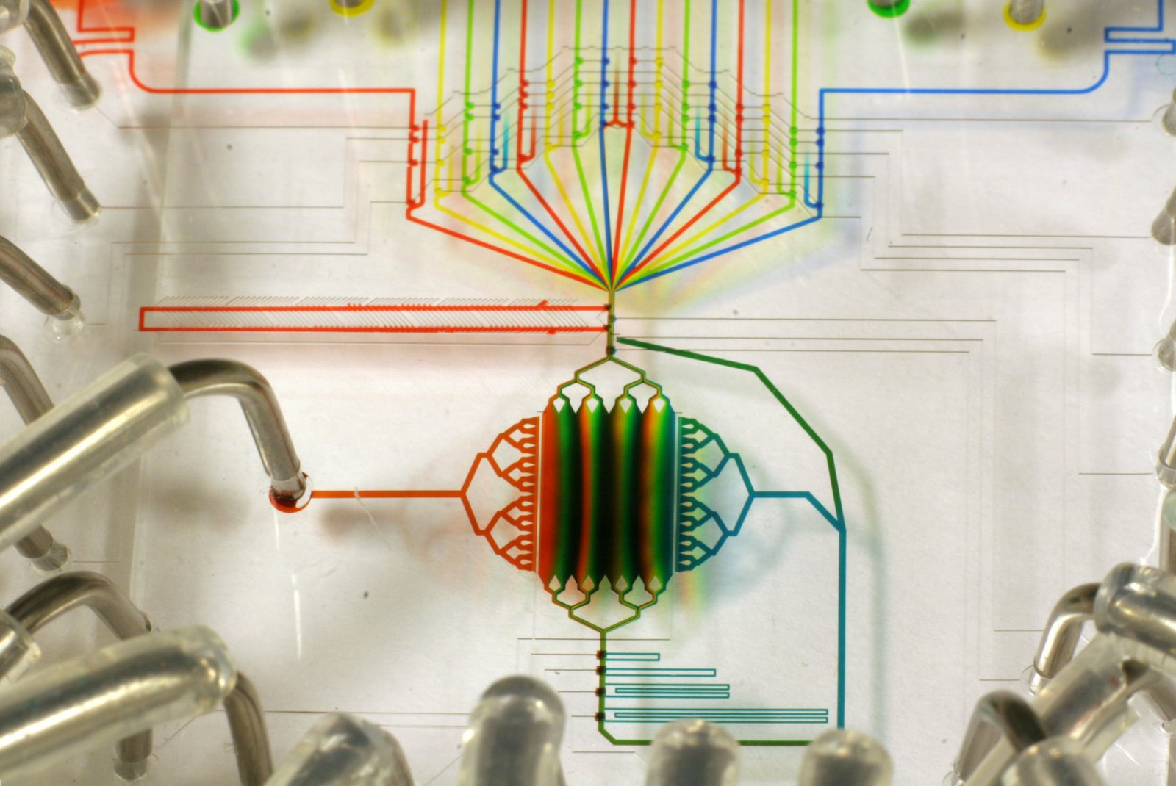
SOME COOL APPLICATIONS
Taken from “lab on a chip” and “Nature” journals:
Cost-effective and rapid blood
analysis on a cell- phone
Lab-on-DVD: standard DVD
drives as a novel laser scanning
microscope for image based
point of care diagnostics
Cells on chips (Nature): spatial
and temporal control of cell
growth and stimuli by combining
surfaces that mimic complex
biochemistries and geometries

Slide 10
µF IN OUR LAB (Prof. Oleg Krichevsky)
Full fabrication facility (besides high-res printer)
Projects:
Studying the effects of field-localization in the communication and fate of the T-cells of the immune system. We use membrane integrated devices for annihilation of convective motion in the medium and high-resolution confocal microscopy
Collect statistics of plasmid copy number distribution within a monoclonal sample of E-Coli, using a fully automated Microfluidics-based process in which all extraction, separation and measurement are performed on the device

Slide 11
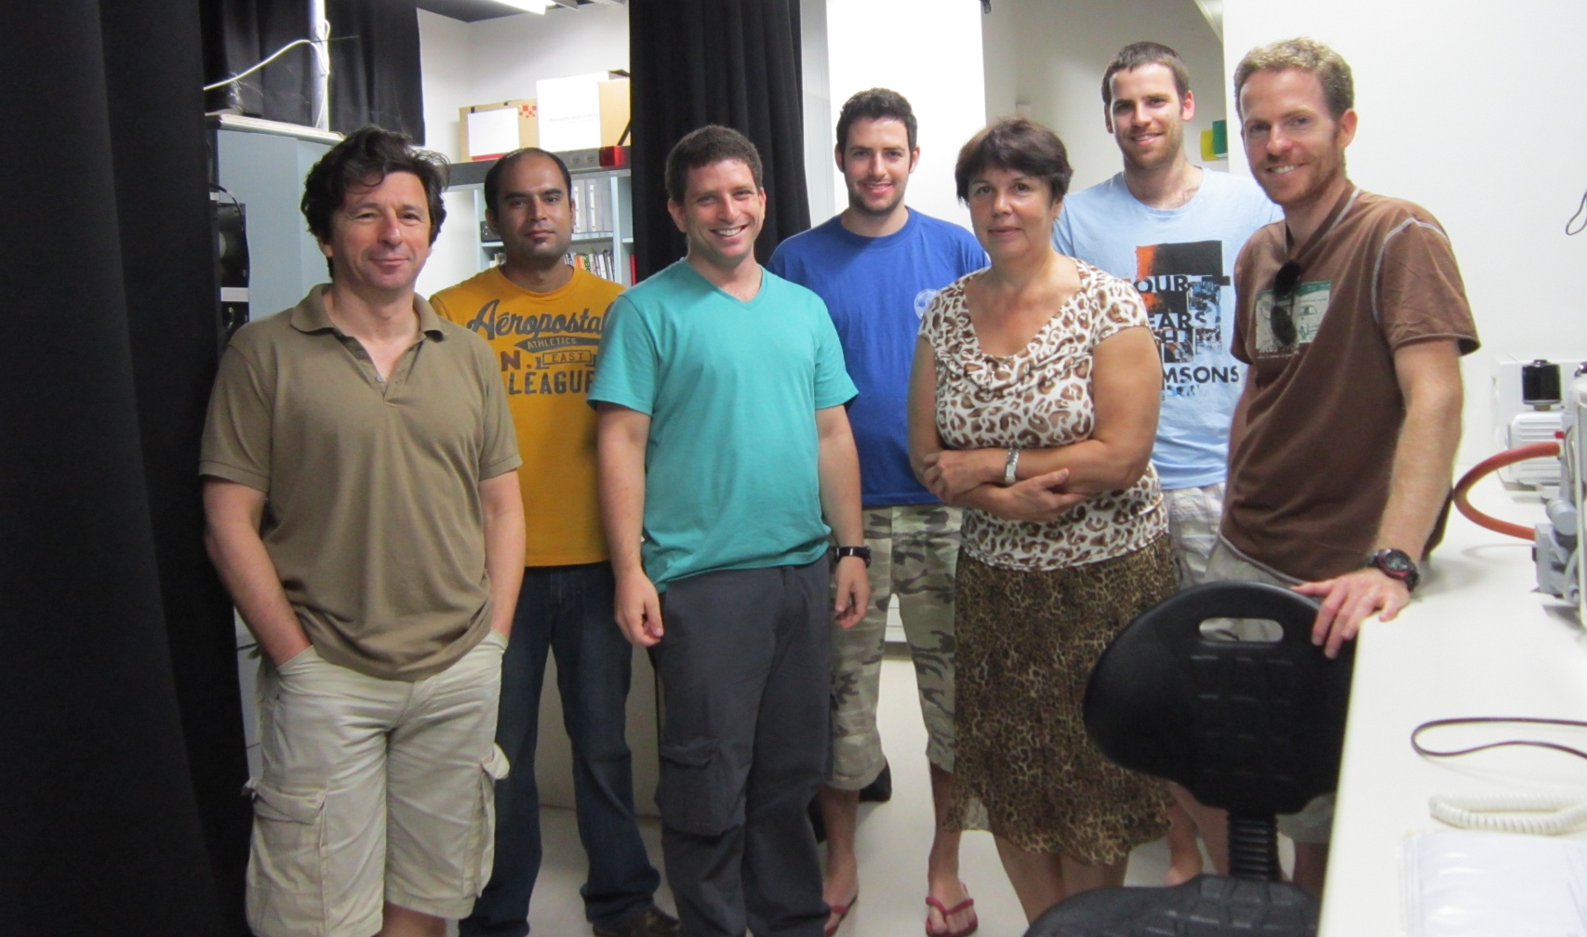
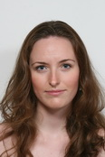
THE PEOPLE @ OLEGLAB
Left to right, top to bottom: Oleg, Manish, Gadi, Rotem, Tanya, Alon, Lior,
Dotan, Irina

Slide 12
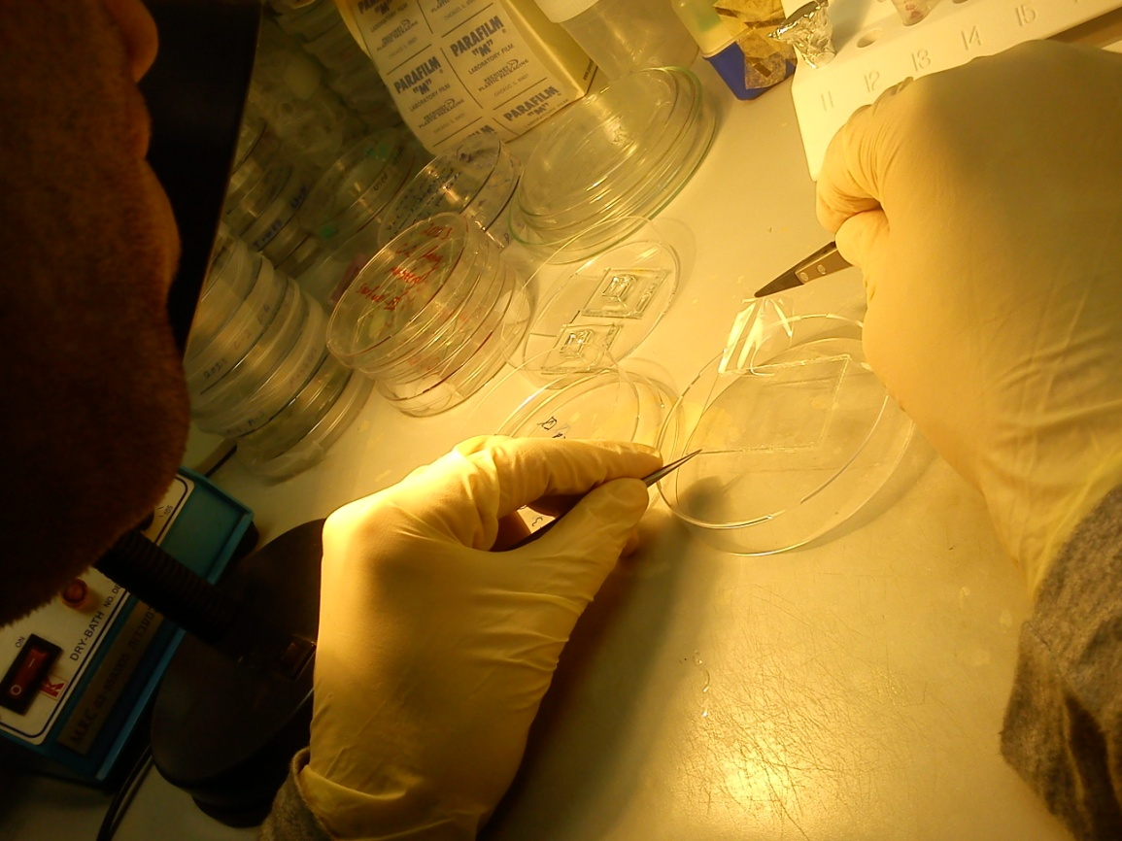
SUMMARY
What is Microfluidics
Going with the
Laminar Flow
One Step Forward –
“Lab on a Chip”
A-Chip-a-Day
Some Applications
µF in our Lab
Thanks!
Questions?

Slide 13
MOVIES

