Slide 1
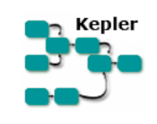
Computational Physics Kepler
Dr. Guy Tel-Zur

Slide 2
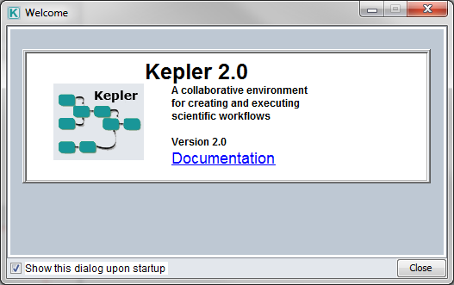
This presentations follows “The Getting Started with Kepler” guide. A tutorial style manual for scientists who want to create and execute scientific workflows.
Home page: https://kepler-project.org/

Slide 3
What is Kepler?
Kepler is a software application for the analysis and modeling of scientific data. Kepler simplifies the effort required to create executable models by using a visual representation
of these processes. These representations, or “scientific workflows,” display the flow of data among discrete analysis and modeling components

Slide 4
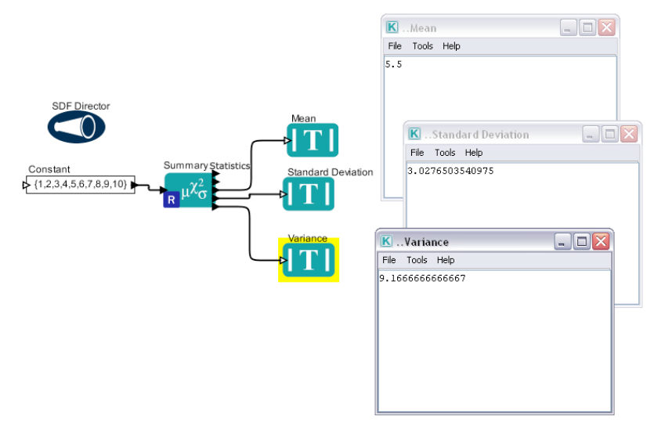

Slide 5
Features
drag and drop
Computation engine is R
But the user doesn’t have to know how to program in R

Slide 6
What are Scientific Workflows
Scientific workflows are a flexible tool for accessing scientific data (streaming sensor
data, medical and satellite images, simulation output, observational data, etc.) and
executing complex analysis on the retrieved data.

Slide 7
Each workflow consists of analytical steps that may involve database access and querying, data analysis and mining, and intensive computations performed on high performance cluster computers. Each workflow step is represented by an “actor,” a processing component that can be dragged and dropped into a workflow via Kepler’s visual interface. Connected actors form a workflow, allowing scientists to inspect and display data on the fly as it is computed, make parameter changes as necessary, and re-run and reproduce experimental results.
Scientific workflows in Kepler provide access to the benefits of today’s grid technologies (providing access to distributed resources such as data and computational services), while hiding the underlying complexity of those technologies.

Slide 8
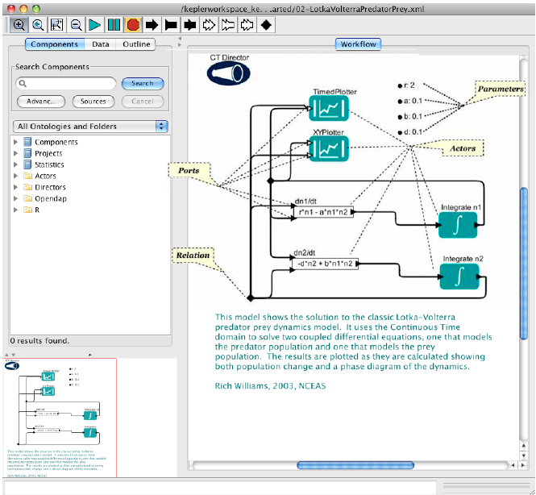

Slide 9
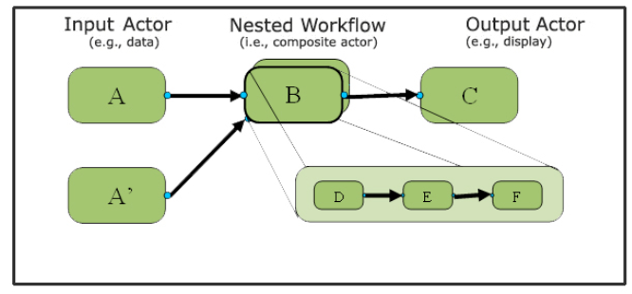
Representation of a nested workflow
Kepler Toolbar

Slide 10
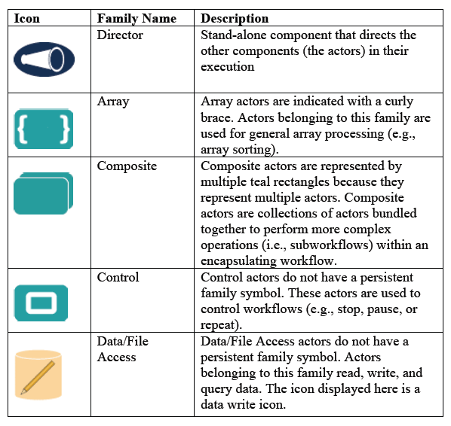
The Major Kepler’s Icons

Slide 11
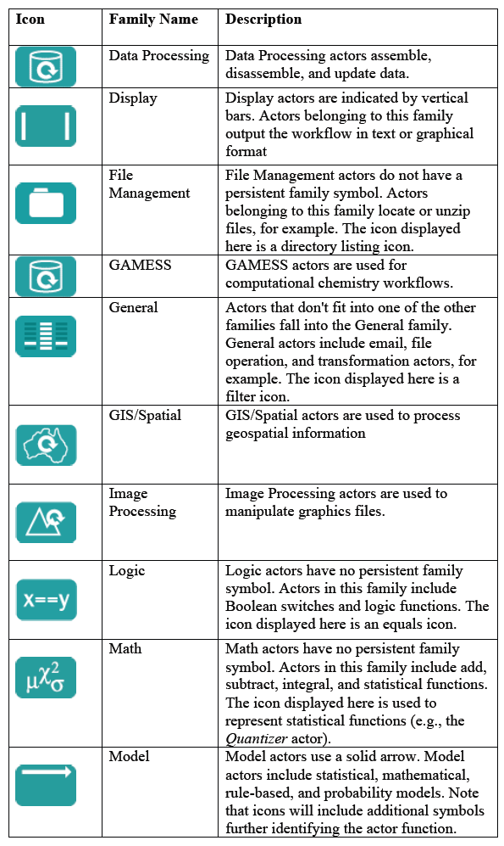
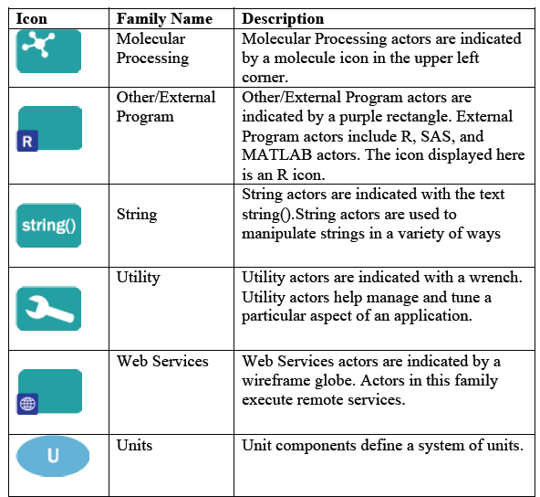

Slide 12
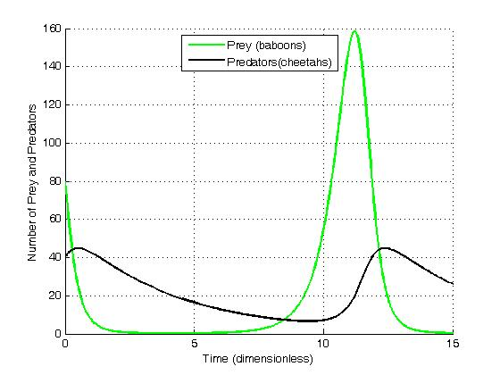
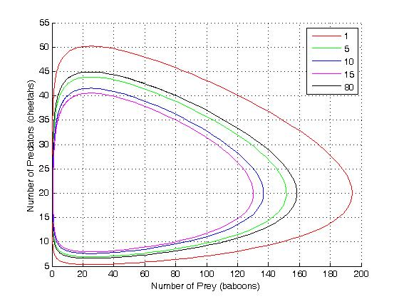
Sample Workflow #1: Lotka-Volterra

Slide 13
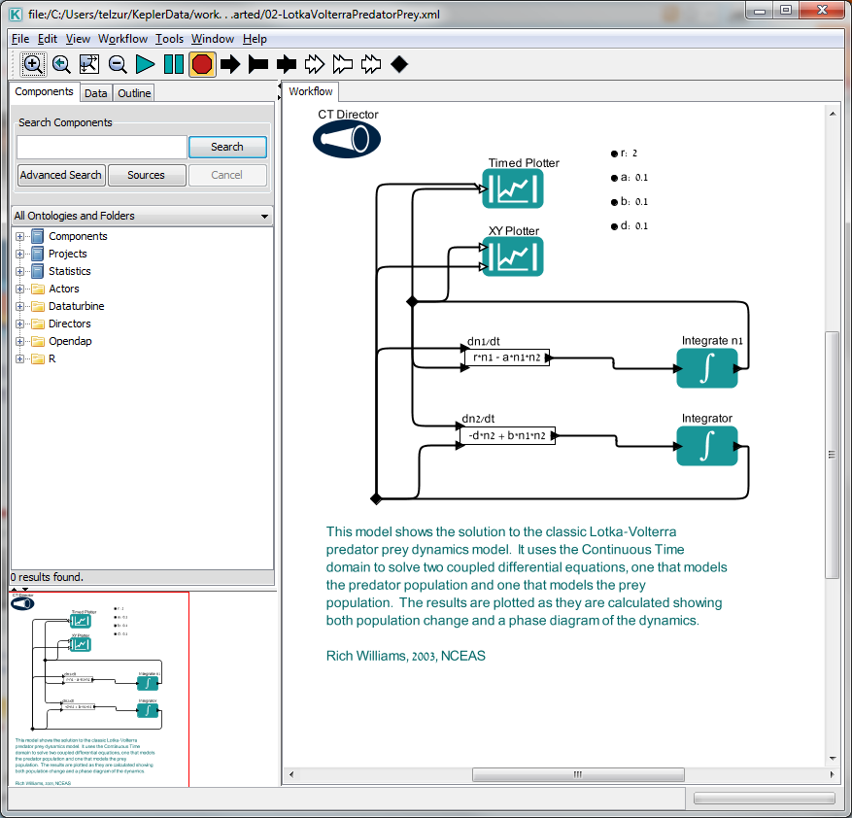
C:\Users\telzur\KeplerData\workflows\module\outreach-2.0.0\demos\getting-started

Slide 14
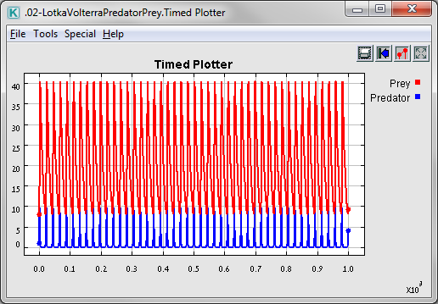
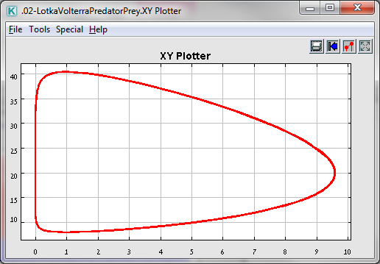

Slide 15
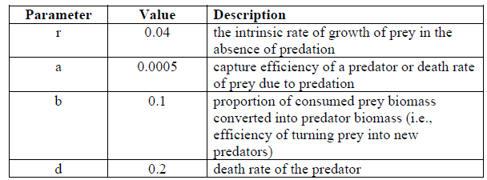
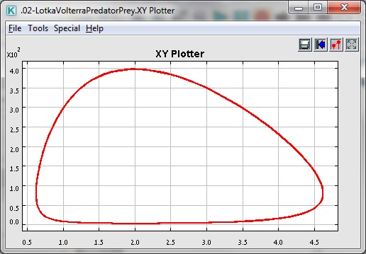
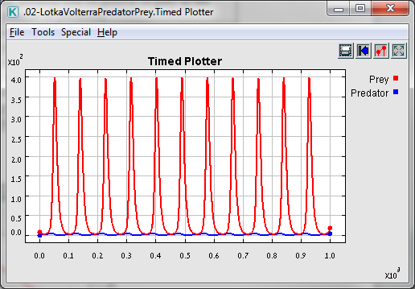
Adjust the workflow parameters as suggested in the Table

Slide 16
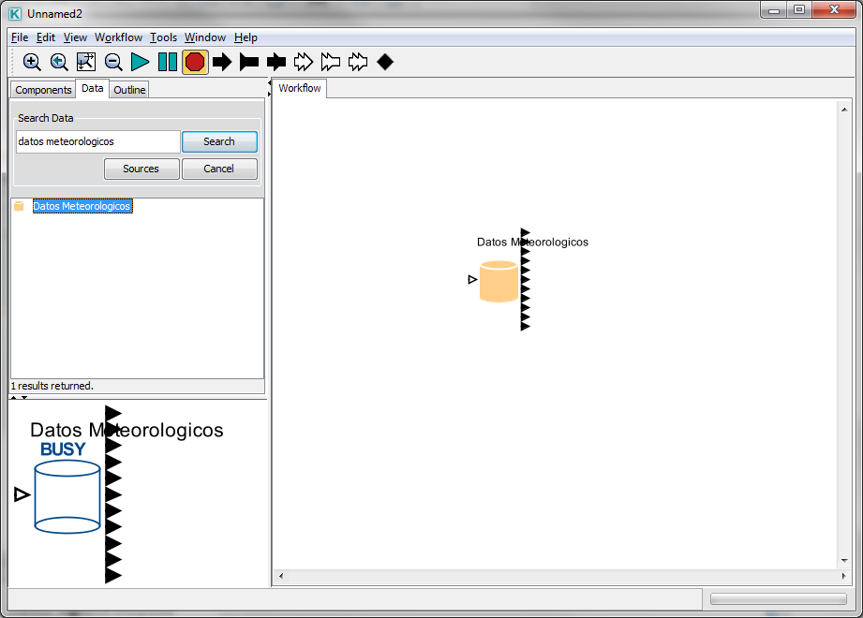
Searching with Kepler
Search for “datos meteorologicos”

Slide 17
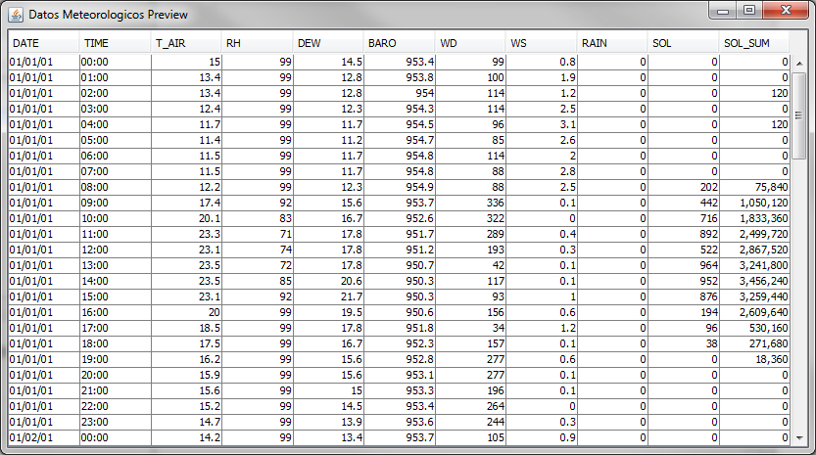
Right click on the actor → Preview

Slide 18
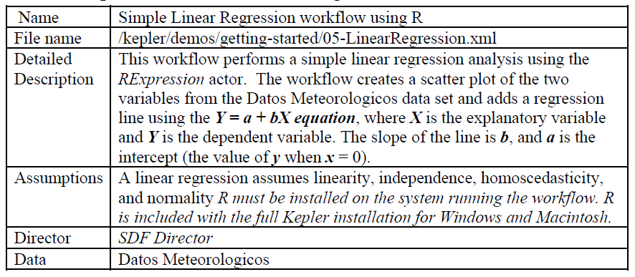
Sample Workflow #2 –Linear Regression

Slide 19
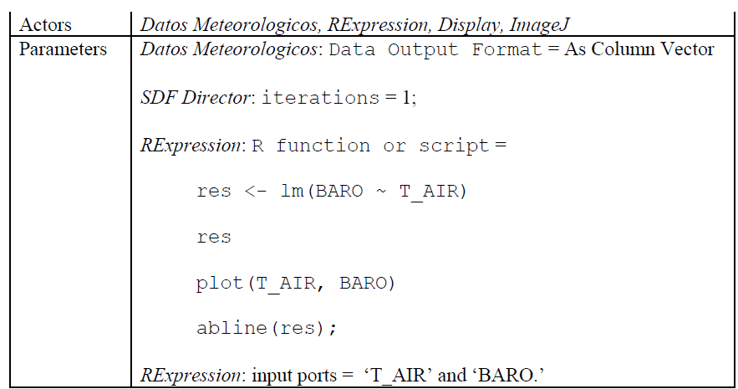

Slide 20
The Simple Linear Regression workflow runs a search for data on the EarthGrid. These
data are used to create a workflow conducting a linear regression. In this example, the
input data comes from two output ports (the data columns on Barometric Pressure and
Air Temperature) of the Datos Meteorologicos actor, a data set of meteorological data
collected in 2001 from the La Hechicera station.
The Linear Regression workflow uses four actors (the Datos Meteorologicos actor, the
RExpression actor, the ImageJ actor and the Display actor) and the SDF Director. The
RExpression actor inserts R commands and scripts into the workflow. The RExpression
actor makes integrating the powerful data manipulation and statistical functions of R into
workflows easy. To implement the RExpression actor, R must be installed on the
computer running the Kepler application.

Slide 21
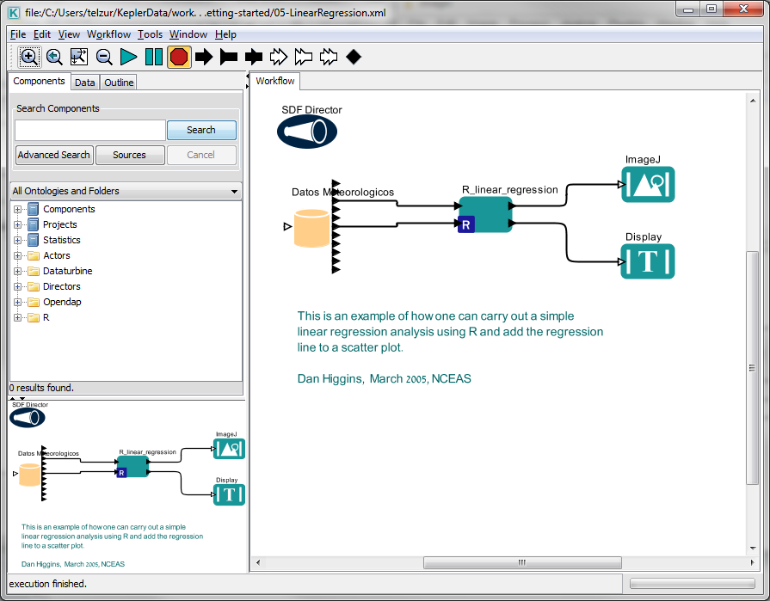

Slide 22
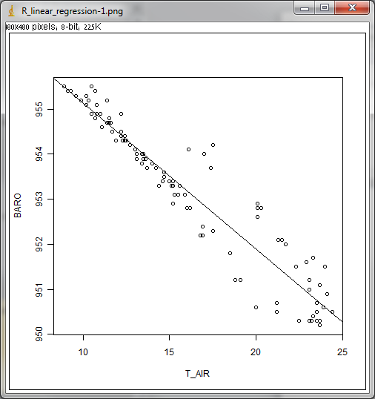
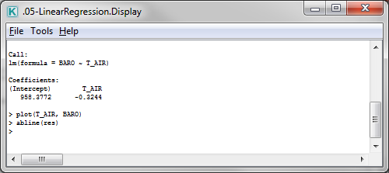

Slide 23
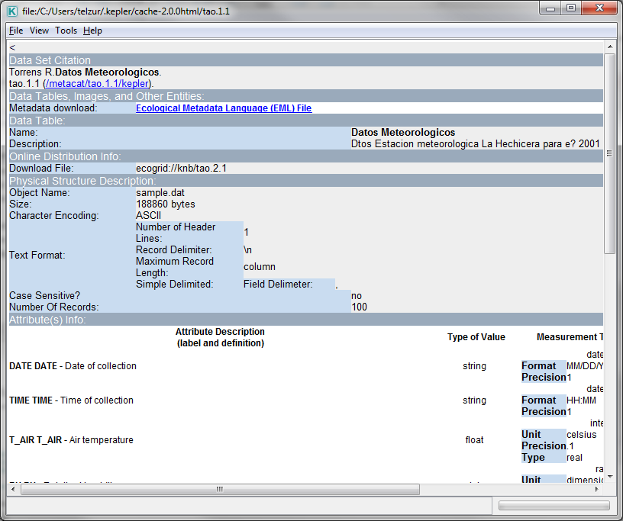
Meta-Data:

Slide 24
Ports configuration for the R-script actor

Slide 25
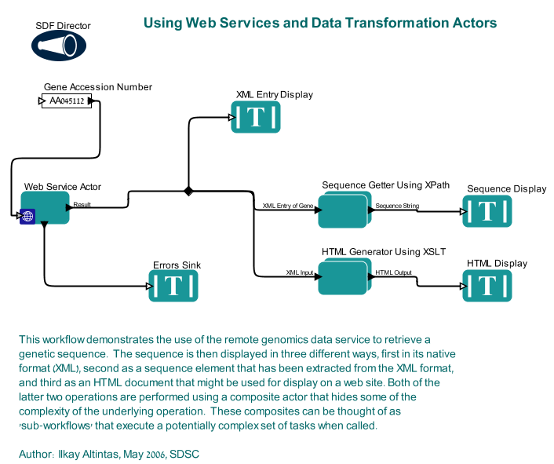
Example #3: Web Services and Data Transformation
למרבה הצער הדגמה זו לא פועלת. יש בעייה להתחבר למאגר הנתונים

Slide 26
Sample Workflow 4 – Execute an External Application from Kepler (ExternalExecution actor)
The ExternalExecution actor can be used to launch an external application from within a
Kepler workflow. The actor can pass values to the application and return values that can
be used or displayed by downstream actors. In order to use the ExternalExecution actor,
the invoked application must be on the local computer and, in some cases, configured
appropriately. In this section, we will look at several examples of workflows that use the
ExternalExecution actor.

Slide 27
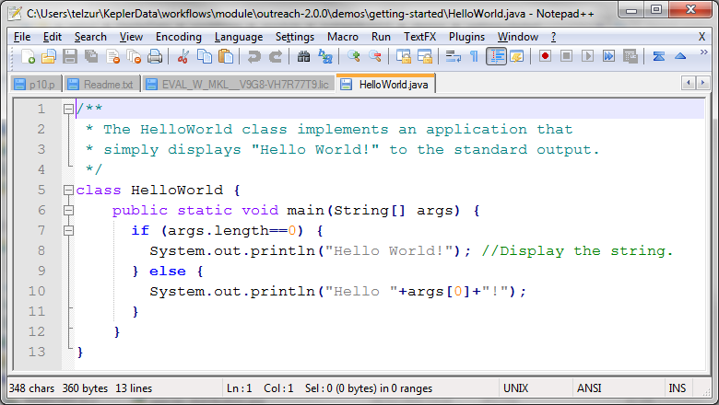
An external Java program

Slide 28
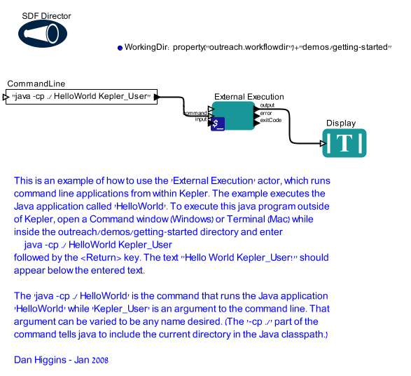

Slide 29
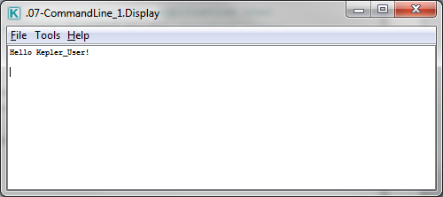
The output window (Display actor)

