Slide 1
Computational Physics Java Analysis Studio
Dr. Guy Tel-Zur

Slide 2
FreeHEP (High-Energy Physics)
http://jas.freehep.org/jas3/
http://www.freehep.org/
http://java.freehep.org/

Slide 3
Example 1 - Java

Slide 4
import hep.aida.*;
import java.util.Random;
public class CreateAndPlotHistograms
{
public static void main(String[] argv)
{
IAnalysisFactory af = IAnalysisFactory.create();
ITree tree = af.createTreeFactory().create();
IHistogramFactory hf = af.createHistogramFactory(tree);
tree.mkdir("/Histograms");
tree.cd("/Histograms");
IHistogram1D h1 = hf.createHistogram1D("Histogram 1D",50,-3,3);
IHistogram2D h2 = hf.createHistogram2D("Histogram 2D",40,-3,3,40,-3,3);
tree.mkdir("/Clouds");
tree.cd("/Clouds");
ICloud1D c1 = hf.createCloud1D("Cloud 1D");
ICloud2D c2 = hf.createCloud2D("Cloud 2D");
IPlotter plotter = af.createPlotterFactory().create("CreateAndPlotHistograms.java plot");

Slide 5
plotter.show();
plotter.createRegions(2,2);
plotter.region(0).plot(h1);
plotter.region(1).plot(h2);
plotter.region(2).plot(c1);
plotter.region(3).plot(c2);
Random r = new Random();
for (int i = 0; i < 100000; i++ ) {
h1.fill(r.nextGaussian());
h2.fill(r.nextGaussian(),r.nextGaussian());
c1.fill(r.nextGaussian());
c2.fill(r.nextGaussian(),r.nextGaussian());
}
}
}

Slide 6
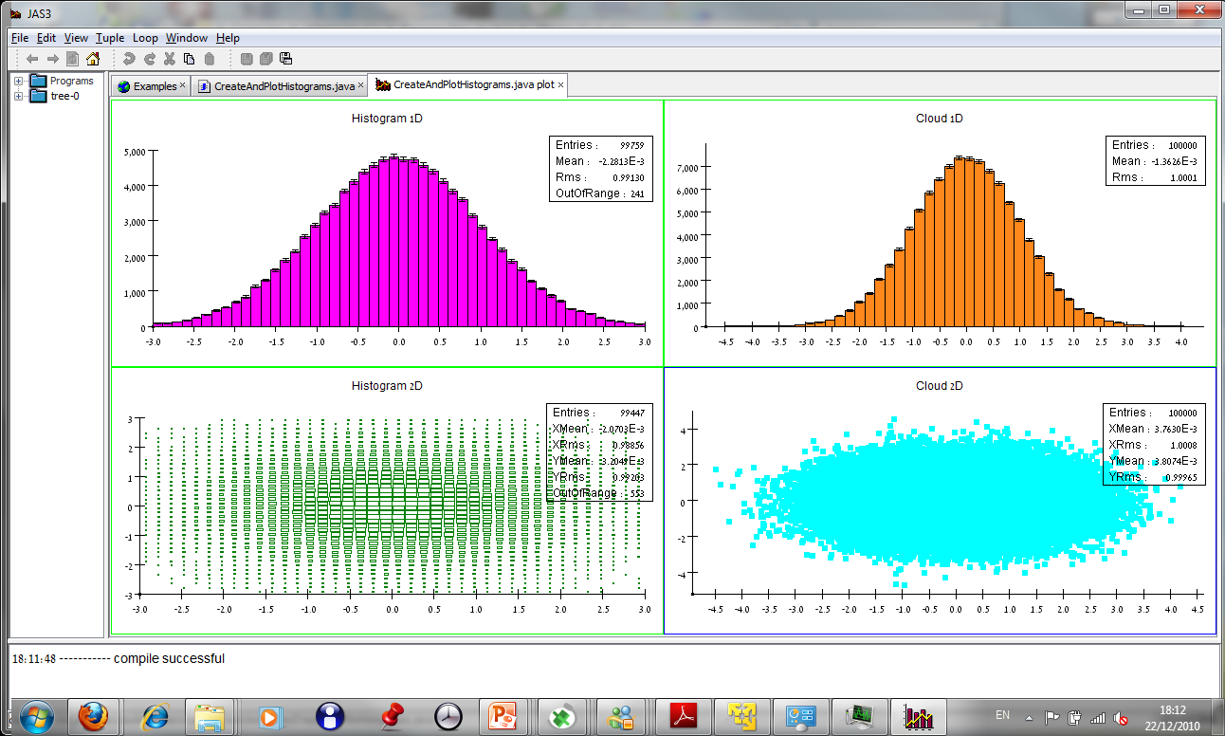

Slide 7
The same code in Python!
from hep.aida import *
from java.util import Random
factory = IAnalysisFactory.create();
tree = factory.createTreeFactory().create();
hf = factory.createHistogramFactory(tree);
tree.mkdir("/Histograms");
tree.cd("/Histograms");
h1 = hf.createHistogram1D("Histogram 1D",50,-3,3);
h2 = hf.createHistogram2D("Histogram 2D",40,-3,3,40,-3,3);
tree.mkdir("/Clouds");
tree.cd("/Clouds");
c1 = hf.createCloud1D("Cloud 1D");
c2 = hf.createCloud2D("Cloud 2D");

Slide 8
plotter = factory.createPlotterFactory().create("CreateAndPlotHistograms.py plot");
plotter.show();
plotter.createRegions(2,2);
plotter.region(0).plot(h1);
plotter.region(1).plot(h2);
plotter.region(2).plot(c1);
plotter.region(3).plot(c2);
r = Random()
for i in range(100000):
h1.fill(r.nextGaussian())
h2.fill(r.nextGaussian(),r.nextGaussian())
c1.fill(r.nextGaussian())
c2.fill(r.nextGaussian(),r.nextGaussian())

