Slide 1
Computational Physics Finite-Elements mini-course using FlexPDE
Dr. Guy Tel-Zur
tel-zur@computer.org

Slide 2
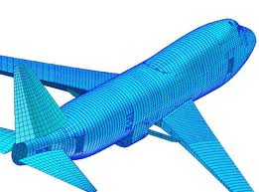
Finite Element in 30 sec.

Slide 3
FlexPDE
Student edition is free but limited
Excellent documentation: http://www.pdesolutions.com/help/index.html?user_guide.html
Rapid prototyping
Easy to use
Recommended to try

Slide 4
FlexPDE
FlexPDE is a "scripted finite element model builder and numerical solver".
FlexPDE is also a "problem solving environment".
The FlexPDE scripting language is a "natural" language.

Slide 5
How Do I Set Up My Problem?
Define the variables and equations
Define the domain
Define the material parameters
Define the boundary conditions
Specify the graphical output

Slide 6
Problem Setup Guidelines
Start with a fundamental statement of the physical system
Start with a simple model, preferably one for which you know the answer
Use simple material parameters at first
Map out the domain
Use MONITORS
Annotate your script with frequent comments

Slide 7
FlexPDE-> file -> new script
Template:
{ Fill in the following sections (removing comment marks ! if necessary),
and delete those that are unused.}
TITLE 'New Problem' { the problem identification }
COORDINATES cartesian2 { coordinate system, 1D,2D,3D, etc }
VARIABLES { system variables }
u { choose your own names }
! SELECT { method controls }
! DEFINITIONS { parameter definitions }
! INITIAL VALUES
EQUATIONS { PDE's, one for each variable }
div(grad(u))=0 { one possibility }
! CONSTRAINTS { Integral constraints }
BOUNDARIES { The domain definition }
REGION 1 { For each material region }
START(0,0) { Walk the domain boundary }
LINE TO (1,0) TO (1,1) TO (0,1) TO CLOSE
! TIME 0 TO 1 { if time dependent }
MONITORS { show progress }
PLOTS { save result displays }
CONTOUR(u)
END

Slide 8
A worked out example
TITLE 'Heat flow around an Insulating blob'
VARIABLES
Phi { the temperature }
DEFINITIONS
K = 1 { default conductivity }
R = 0.5 { blob radius }
EQUATIONS
Div(-k*grad(phi)) = 0
BOUNDARIES
REGION 1 'box'
START(-1,-1)
VALUE(Phi)=0 LINE TO (1,-1)
NATURAL(Phi)=0 LINE TO (1,1)
VALUE(Phi)=1 LINE TO (-1,1)
NATURAL(Phi)=0 LINE TO CLOSE
REGION 2 'blob' { the embedded blob }
k = 0.001
START 'ring' (R,0)
ARC(CENTER=0,0) ANGLE=360 TO CLOSE
PLOTS
CONTOUR(Phi)
VECTOR(-k*grad(Phi))
ELEVATION(Phi) FROM (0,-1) to (0,1)
ELEVATION(Normal(-k*grad(Phi))) ON 'ring'
END

Slide 9
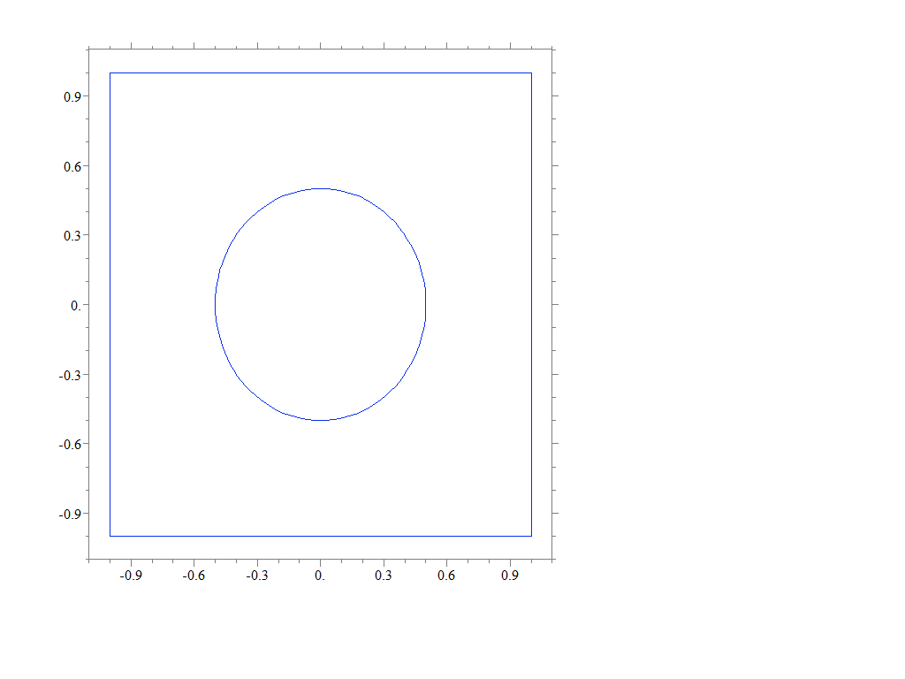
Problem domain

